Slide 1
Social dialogue in the public sector – the Norwegian experience
Conference: Local Government Management Leader 2020 Local government as an employer - Social dialogue for decent work 23 September 2020

Slide 2
Fagforbundet - Norwegian Union of Municipal and General Employees
Largest union in The Norwegian Confederation of Trade Unions
More than 390.000 members
80% of our members are women
More than 100 occupational groups, in the public sector, in local and county government and in hospitals, as well as in the private sector.
Notes:
Fagforbundet has shop stewards and trade union representatives at all levels of the country’s administration: national, county, municipal and organisational. Fagforbundet is made up of more than 550 local branches. Each local branch is a fully functional trade union where members elect their local representative. Fagforbundet has nearly 17,000 experienced shop stewards across the country, and 18 county level organisations. Fagforbundet also gains strength from being under the umbrella of the Norwegian Confederation of Trade Unions.

Slide 3
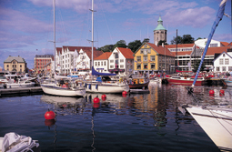
KS - Norwegian Association of Local and Regional Authorities
Member organization - all 356 municipalities and 11 county councils in Norway are members, in addition to 500 public enterprises
Three main functions:
Represents the interests of its members vis-à-vis the central government and Parliament
Provides legal, financial and administrative advice for members, commissions research and contributes with expert assessments
Employer organization that negotiates with unions on behalf of 366 local and regional authorities – all except Oslo

Slide 4
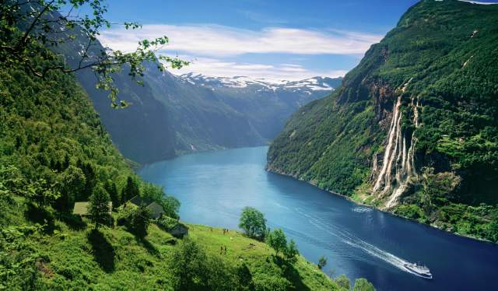
Norway in a nutshell
5.3 million inhabitants
Capital city Oslo, 676.000 inhabitants
Second largest city Bergen, 280.000 inhabitants
More than half a million persons are employed in the public sector
More than 80 percent of the employees in the public sector are organised in a trade union
Photo: Visit Norway

Slide 5
The Norwegian model
A crucial feature of Norwegian political life is social dialogue and tripartite cooperation.
A century of collective bargaining and representation of advocacy groups in political arenas have resulted in:
Universal and well developed welfare services
High employment among both men and women
Low unemployment rate
Small wage differences and a large degree of social mobility
Well organised labour market
Centrally co-ordinated wage formation and local bargaining at municipal/company level
Elaborated funding of pensions
Close co-operation between the government, employers’ associations and trade unions as well as strong co-determination and participation at the company level
Notes:
The main principles of the tripartite approach in Norway:
Wages are set in tariff agreements, which are the result of highly centralised negotiations between a few big unions and employers
Given their size, trade unions have an incentive to take into account the impact of wage increases on unemployment
In order to avoid increased unemployment, overall wage growth is restricted to what export-oriented industries are able to offer while remaining competitive
Its is a form of negotiations facilitates an emphasis on common interests and a fairly equal distribution of income

Slide 6
Social dialogue and tripartite cooperation
Social dialogue: a broad concept, including the dialogue between groups in a society, including NGOs, the church etc.
Tripartite cooperation: a specific concept including, the employers’ organisations, the trade unions and the state/government. Also tripartite social dialogue, or bipartite social dialogue, which involves only workers and employer.
Culture of trust extended to local government/municipalities; mayor/local politicians, administrative leaders and trade union representatives.
Social dialogue builds trust among the participants.
Government /Central authorities
Social dialogue
Tripartite cooperation/social dialogue
Employers’ organisations
Trade unions

Slide 7
Characteristics of social dialogue in Norway
Large degree of trust between the social partners
Predictability in relations
A willingness to find solutions
Strong relations between both:
Central trade unions and employer organizations
Local trade unions and the municipalities/regions/enterprises.
Notes:
What are the characteristics of social dialogue in Norway?
The mentioned characteristics of social dialogue is not a recent development, but to maintain these characteristics it is a necessity to - never promise more than you can keep - and keep what you have promised.
The high union density is important to the functioning of our system, and for the legitimacy of the agreements reached.
We have long standing, and predictable relations, there is often a willingness to find solutions – and this is often based on a mutual understanding of challenges.
There is also strong relations between the confederations and KS and the employer organzations and also between local trade unions and the municipalities/regions

Slide 8
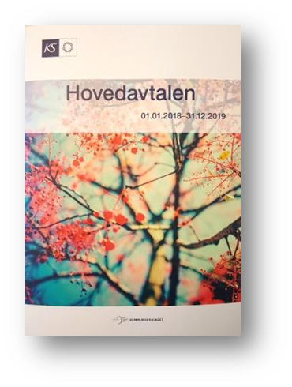
Collective agreements: backbone of the Norwegian model
Two main agreements:
The Basic Agreement – The constitution of social dialogue
Sets predominant rules of the game with regard to conflict resolution and negotiation mechanisms between employers and trade unions, while describing the rights and obligations of both parties
First formulated in 1935, continually updated since
The National Collective Agreement
Fixes wages and general employment terms (pay during sickness, maternity leave, working hours, holiday, etc.) for a whole sector on a national basis
A minimum wage agreement, local freedom to pay more
Notes:
The two most important agreements are the Basic Agreement – and the National Collective Agreement
These two agreements are negotiated every second year.
The Basic Agreement: Gives ”the overall rules of the game” – Could be described as “The constitution of the Social Dialogue”.
The Basic Agreement has three sections A, B and C.
A: the negotiation/bargaining system –
Who can enter into agreement, what type of agreements are permitted, the right to negotiate, procedures for strike and lockout, conflict of interest resolution, litigation, mediation
B: Cooperation between employers and employees by their union representatives – Types of codetermination, cooperation in reorganization/restructuring and development, union representation and the duties and rights of employer and union representatives, bipartite working groups etc.
C: For enterprises, the same agreement as for authorities, with some adjustments.
Two basic principles:
Public sector is managed by elected councils
The employees shall have the right of influence and co-decision in matters concerning their job situation or workplace.
From the introduction/preamble:
The central social partners (organisations) have entered into this agreement in order to create the best possible foundation for cooperation between the social partners on all levels.
The agreement shall be a means to create cooperative relations between employers and employees and the development of high quality public services.
The cooperation must be based on trust and mutual understanding of the roles of the different parties.
The employees and their Unions shall be involved as early as possible when reorganisation and reforms are implemented.
The central social partners will by themselves and together contribute to good local processes and follow-up by the local partners of the intentions in the Basic Agreement.
Regulates the right of the employees to influence and co-decision in organisational matters that will influence on their workplace/conditions.
Regular meetings between the parties to the agreements.
Follow-up and training: implemented by KS and the Unions together
The other important agreement is the Basic Tariff Agreement/National collective Agreement.
The Basic Tariff Agreement: Re-negotiated every 2 years, but with annual wage-adjustments.
The Basic Tariff agreement pay and pension, general employment terms such as pay during sickness, maternity leave, holiday, notice of termination, working hours, rest periods, days of rest etc.
The annual wage-adjustments can be a combination of Central and a local negotiations. Central decision about the economic split between central and local economic framework. Central bargaining/control with what influences on macroeconomic aspects. The rest negotiated locally. “Income-policy cooperation” – see the whole picture.
Important to note: There is an agreement between the social partners on the statistical and economic basis and framework: teknisk beregningsutvalg for kommunesektoren. “Technical statistics and calculation board” for the wage-adjustments.
And additionaly: 25 special agreements

Slide 9
The Working Environment Act
The original law was passed in 1977, the current version is from 2015
Ensures safe working conditions and equal treatment among workers, covering topics such as:
fundamental working environment standards
working hours
regulations for children and youth
right to paid or unpaid leave
protection against discrimination
procedures relating to hiring and termination of employment
Notes:
The original law was passed in 1977, the current version is from 2015
Covers both public and private enterprises and institutions, and incorporates the EU directive on work environment into Norwegian law

Slide 10
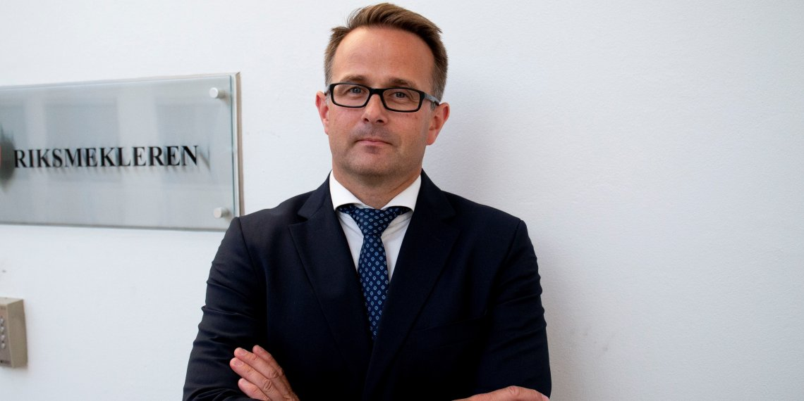
Mediation and disputes
The Labour Disputes Act the legal basis for mediation
National Mediator (Riksmekler) is appointed by the Government
National Mediator must be notified for of all strikes and lock-outs beforehand
Local wage bargaining break-downs is solved by arbitration (in the public sector)
Mats Wilhelm Ruland, Riksmekler/National Mediator from 2018
Notes:
There is also an important legal framework for collective agreements and negotiations.
There is of course many aspects of the working environment that is regulated through legislation, and this regulation is in many cases overlapping the collective agreements.
But there is also a Labour Disputes Act, that regulates disputes between the employers and unions, and is the legal basis for mediation in conflict situations.
There is a National Mediator which is appointed by the Government.
The National Mediator must be notified for all strikes and lock-outs beforhand.
In local wage bargaining break-downs KS and the Confederations can solve the disputes by arbitration

Slide 11
Municipal tripartite cooperation
Constructive cooperation between local elected politicians, administrative leaders and union representatives. The aim is to create a culture of cooperation and to work together to find the best solutions for the municipality’s challenges.
Notes:
The definition made by the three parties on national level, the Ministry of local government, trade unions and the Norwegian Association of Local and Regional Authorities. Both formal and informal cooperation in different arenas are building trust.

Slide 12
Working for common goals builds trust
For employers:
Workers are the most valuable resource for employers
Decent work and salaries mean more satisfied workers
Satisfied workers may mean increased productivity
New roles for employers: empowering and motivating highly qualified workers – not mainly controlling
Change of employers’ attitude
Mutual trust
For workers:
Close to clients/citizens (close to production)
Knowledge, also tacit knowledge
Empowerment and trust increase productivity
Engaged employees:
make good decisions
act for the common good
are not only in it for the money
Notes:
Willing and able employees, fundamental for innovation and development/quality public services

Slide 13
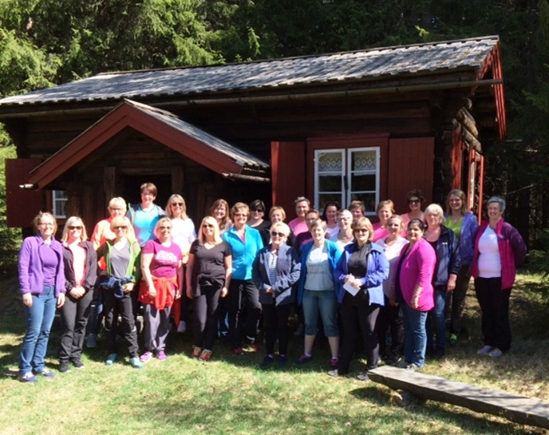
Regular dialogue at the workplace
Nurses, assistant nurses, and other employees have 3 different labor unions
Each union has elected representatives at every workplace and one centrally in the municipality
The local representative has dialogue with the local leader
The central representative has dialogue with the top leadership

Slide 14
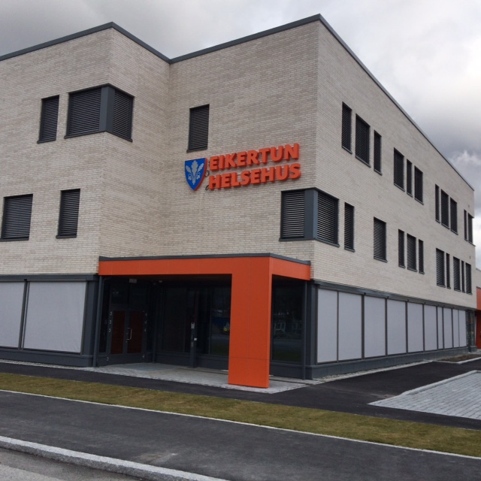
Two examples
We wanted to centralize and collect the nurses in home care, in one base to ensure common practice
Many against
We had lots of dialogue, information
We agreed in SMIA
Corona crisis made it necessary to change some employees work hours; from 7 hours shifts to 12 hours shifts
Representative for the Nurses Union at the municipal level was against
Representatives for Nurses and for Assistant Nurses at the workplace were pro
Dialogue – agreement – so far

Slide 15
What are the results?
Elected representatives know and understand operations
Representatives are well informed and included in respectful dialogue and they contribute to better decisions
A question of leadership
and of elected representatives having sufficient training and knowledge
The representatives contribute to implementing important and necessary changes
We respect each others roles and have the same goals for our services to our patients/users
The collective agreements (made by KS and the National Labor Unions) on wages, work hours, rights and duties is crucial and at the bottom of our cooperation and development locally

Slide 16
Social dialogue and trust – opposed to detailed control
Involvement, empowerment and cooperation is more effective than control and management of distrust.
National development programs over the last 20 years, in close cooperation between ministry, national confederations of trade unions and the employers association for municipalities (KS), experience show:
Involving the management from the various municipal administrations, trade union representatives and local politicians, improves the quality of public services and the political drive to privatise lose speed
Formal and informal cooperation in different arenas build trust
Many arenas for involvement and cooperation create a better social dialgoue

Slide 17
National programmes for tripartite cooperation in the municipalities
Pilot: Model municipalities 1999–2010
Quality in public services 2007–2010
First national programme on tripartite cooperation in the municipalities
Together for a better municipality 2011–2015
New municipalities 2017–2019
A national program for the social partners to cooperate for the best possible reform process for new municipalities and counties
Cooperation on digitalisation and competence in the municipalities (2017-19)
To increase involvement of all social partners in digitalisation processes
Next: Possible cooperation on reaching the UN Sustainable Development Goals in the municipalities.
Notes:
Started its own Model municipality project in 1996-1997. Successful. Initiated a cooperation nationally for programmes to encourage local tripartite cooperation. More than 60% of all municipalities have participated in one or more of the national programs (Now 356 municipalities).
Over the last 10 years, the national ministry in charge of local government has collaborated with the Norwegian Association of Local and Regional Authorities (KS) and the four largest national trade unions to support programmes in the municipalities.
Fagforbundet has played a central part in these programmes. In order to qualify for participation in the programme, municipalities had to base their projects on local tripartite cooperation among local politicians, administrative leaders and employees and their trade union reps. More than half of Norway’s 426 municipalities have been involved in the programmes, covering topics such as reduced sick leave, full-time work, skilled labour, communication and innovation. Both internal and external evaluations of the programmes have been positive. The Norwegian Institute for Urban and Regional Research evaluated some of the earlier programmes, with sound results.
Quality public services (2007-2010) (kindergarten, education, health and social services)
Together for a better municipality (2011-15), (full time, permanent jobs/qualifications/reduce absenteeism, innovation
Employees play a key role in developing their workplaces. Together with administrative leaders of the municipalities and local politicians these actors recognize the mutual benefit of involving each others experience and input, for better decisions and more effective results.

Slide 18
Digitalisation
Cooperating on the municipality’s digitalisation strategy:
«By cooperating with each other – politicians, trade union representatives and managers – with the strategy we obtain more than just the strategy
paper. We learn from the process of working
together. When the final strategy is understood
by all parties, it will also be implemented more effectively.»
Shop steward in Fagforbundet, Renate Fagerness Sjøenden and head of development in Porsanger municipality, Kjell Rasmussen.

Slide 19
Tripartite cooperation in Melhus, Malvik and Steinkjer municipalities
Fagforbundet engaged the research institute, Sintef, to measure the impact of tripartite cooperation in three selected municipalities.
The aim of the two and a half-year long project was to improve the working environment by increased cooperation and social dialogue between the trade union and the employees, the management, and the health safety and environment representative on the organisational level in kindergartens and nursing homes in the municipalities.
Documented results:
Reduced sick leave
More confident and active trade union representatives
Improved foundation for making decisions and increased support for management
Trade union representatives cooperated closely with management on common goals
Notes:
Fagforbundet is systematically building knowledge and experience on the “ local tripartite model” of participation and development by working with committed municipalities and research institutions. One example is this cooperation with Sintef.
The research report from Sintef in short:
The report is about a two-year tripartite collaboration for strengthened development in three Norwegian municipalities, Steinkjer, Melhus and Malvik. Trade union representatives, management and safety and health representatives at three kindergartens and three nursing homes have been trained to use social dialogue as a way to improve the services. Municipal tripartite cooperation is a tool for the development of good working environment, effective organisation of work, and even better service quality. Everything framed in political priorities in the municipalities. The research institute SINTEF calls this cooperation “close to business cooperation” because it is complementary to municipal tripartite cooperation and formal social dialogue regulated by the law. The project has been carried out with an action research design. When establishing an operational tripartite cooperation, we see when it is necessary to exercise to establish trust, and gain competence in conducting participation-based development work, and ensuring a well-functioning structure of cooperation between the parties. At the local level this is a necessary tool for improvement and development. The main finding is that the manager of the nursing home or kintergarden, the shopkeeper and the safety representative have become more confident in understanding their own role and have moved to the line of cooperation. Good collaboration at the workplace level, provides the municipal tripartite cooperation an operational body to implement policy decisions, but is also a quality assurance system for the operating units to provide good service quality. When the municipal tripartite cooperation gets its own "operating unit" organised through representative development groups in the workplace, they get what we call a tripartite cooperation close to service.

Slide 20
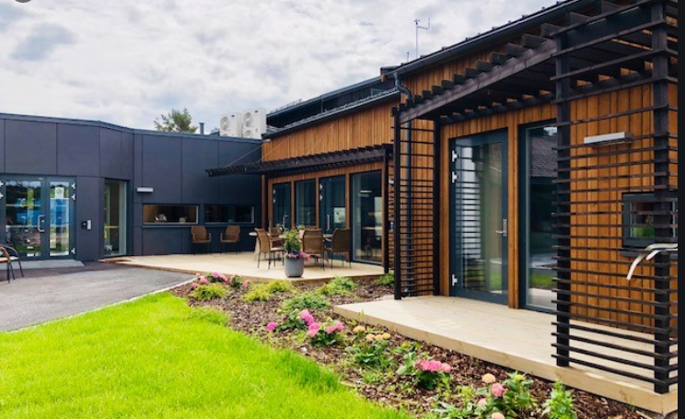
Tripartite cooperation in a nursing home in Hvaler municipality
More effective working routines and more clear responsibility for tasks
Increased insight and control of the services for local politicians
Improved recruitment for skilled personnel
Reduced turn-over
Reduced absenteeism due to illness

Slide 21
Inclusion of immigrants in Frøya
Frøya municipality is growing in terms of inhabitants and most of the new citizens are foreigners.
The municipality used social dialogue to create an efficient way to welcome immigrants into the municipality.
In close cooperation with the local business community and volunteers the immigrants got the right qualifications and language skills that were needed in the municipality.
Several of the management positions in the municipal administration are held by immigrants.
Vida Zubaite Bekken, originally from Lithuania, is project manager in the municipality.
Notes:
Vida Zubaite Bekken, originally from Lithuania, is project manager in the municipality. She is displaying the new integration plan for minority children – from kintergarden to high school.

Slide 22
Social dialogue factors for success:
Common goals
Pull in the same direction
Trust and transparency
Defined roles and contributions
Respect the different roles and interests
Engagement and commitment
Good meeting culture, with defined rules and prepared agenda
Active, solution oriented project-participants
Notes:
Here are some core values that we find critical in Norway, to underpin the social dialogue and build trust:
- Values like openness and transparency are critical to make social dialogue work in general. But Involvement of social partners can also be a powerful way to combat tentensies or signs of corruption. Clarity about mutual interests to achieve better results require openness at every level, including financial resources and how money is spent.

