Slide 1
Digital transformation
Porsgrunn municipality
2020

Slide 2
Digital transformation
The public sector is in need of a radical digital transformation in order to keep up with the general level of technological progress in society

Slide 3
Notes:
Now we have to digitalize!

Slide 4
Digital transformation
This illustration of digital transformation demonstrates that it is often not sufficient to simply digitalize today’s services and processes. In order to satisfy increased expectations of an efficient, user-friendly and open management, we need to be innovative and possibly conceive of new ways of solving the challenges of local governance.
Notes:
Traditional:
Radio: Analog radio. Uneven sound quality, the choice of music is made by the radio host, people calling in are selected by the broadcaster
Public service: PDF form. The user downloads an application form accessible as a pdf document online, fills it out, and submits it via regular mail or e-mail.
Transition:
Digital radio: Greatly improved quality, broader range of radio stations, additional functions. The broadcaster is still in control of the content and the people calling in
Electronic forms: The PDF form is converted into an electronic form that is filled out and submitted directly on the site. Some payments can be made online.
Transformed:
Streaming: Digital quality accessible anywhere, adapted to each unit and with additional functions. The listener is in control – he/she is choosing the content, reviews it, provides comments and shares it with others
Full digital maturity: We work with the users to understand their needs. Departments work together to provide common services. As a result, the public sector adjusts and adapts their services. The processes are digital and and available for all users.

Slide 5
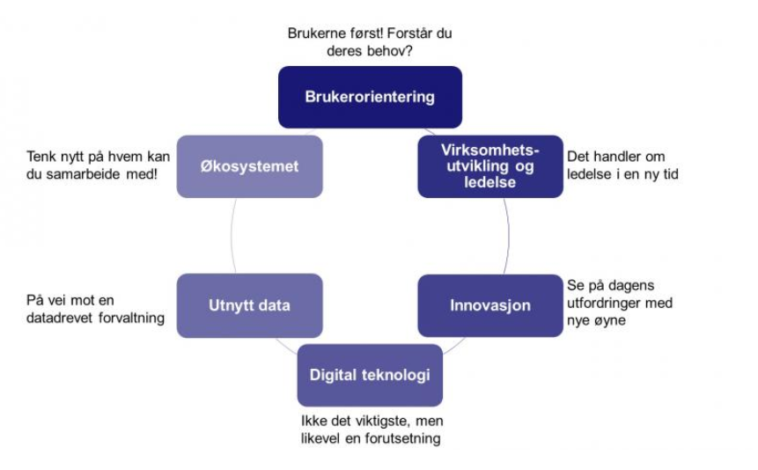
Digital transformasjon
Notes:
(Clockwise from the top):
Box: Focus on the users
Users first! Do you understand their needs?
Box: Developing services and management structure
It’s about leadership in a new era
Box: Innovation
Look at today’s challenges with new eyes
Box: Digital technology
Not the main point, but still an important precondition
Box: Utilize data
On our way toward data-driven management
Box: The ecosystem
Think about who you can cooperate with

Slide 6
Notes:
Many things will affect the tasks and challenges of local governments in a globalized and digitalized future in which employment and competence building transcend borders. The importance of knowledge-sharing and specialization will increase. In Norway, the demography and settlement patterns are changing. The share of elderly people in the population is increasing, while there is a strong tendency of centralization, whereby more people move from rural areas to larger cities. It is especially younger people who move to the city, which means that an increasing proportion of new births take place in cities as well. A consequence of these developments is that it is more difficult to fill positions with qualified candidates, and to cover the increasing need of services to an ageing population.
Young employees have different expectations to their employer. A job is not only a means to earn a living, but also an identity marker – it provides meaning and the opportunity to self-realization. Digitalization is contributing to new ways of working and providing services. All these factors will strongly affect the local government sector and its role as employer in the future.

Slide 7
Digitalization Strategy
Valid for the period of 2018-2020
Based on the most recent template from KS, adopted in 2017
The target group is the politicans and management of Porsgrunn municipality
The next step will be to develop a digitalization strategy for the municipal organization as a whole

Slide 8
General outline of the strategy
Porsgrunn’s strategy incorporates the five main priorities defined in the template provided by KS:
Focus on the user
IT technology as a means for innovation and productivity
Strengthened digital competence and participation
Efficient digitalization of the public sector
Sufficient privacy protection and informaton security

Slide 9
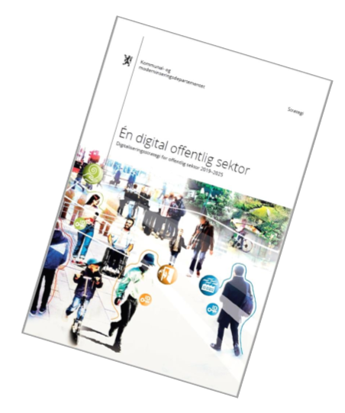
De prioriterte områdene
Sammenhengende tjenester for brukeren
Deling og tilgjengeliggjøring av data
Digitaliseringsvennlig regelverk
Samarbeid med privat sektor
Økosystem for nasjonal digital samhandling
Digital sikkerhet
Økt digital kompetanse
Notes:
A single digital public sector
Digitalization strategy for the public sector 2019-2025

Slide 10
Priority areas
Interconnected services for the user
Sharing and availability of data
Rules and regulations adapted to the digitalization process
Cooperation with the private sector
Ecosystem for national digital coordination
Digital security
Increased digital competence

Slide 11
Notes:
The term «digitalization» is not only used to describe the conversion from analogue to digital data, but also the process of introducing digital technologies that lead to more efficient processes and lead to changes in daily life.

Slide 12
A targeted effort
In order to properly start the digital transformation in Porsgrunn, there is a need to formulate clear measures and comprehensive plans
In order to accomplish the overriding targets in the adopted strategy, a targeted effort is key
Many different divisions and departments in the municipality have already the begun the digitalization process, but often within limited areas
A particular focus on the value of learning form others in order to find good and efficient solutions

Slide 13
DigiForum
A digitalization forum with representatives from each section of the municipal organization is established. The task force is managed by the chief executive’s management group
The forum has helped providing an overview of the current state of digitalization in Porsgrunn in order to create the foundation for more concrete measures and plans
It coordinates the overall digitalization process in the municipal organization
It fuctions as a discussion forum for issues releted to the municipality’s digitalization process and follows up on the implementation of the digitalization strategy

Slide 14
Mandate
DigiForum
Styringsgruppe
Dialog/
informasjon
Oppfølging/
styring
Strategi
DigiForum skal informeres om alle planer og ønsker om anskaffelse av nye systemer. Dette for å sikre korrekt gjennomføring av anskaffelse og riktig medvirkning i anskaffelsesfasen.
DigiForum vil også koordinere og prioritere innføringen av nye systemer i organisasjonen, og sikre at vi ikke kjøper inn systemer vi allerede har.
Ansvar for å legge til rette for gode strategiske valg knyttet til digital transformasjon i Porsgrunn kommune
Styring og rapportering
Overordnet ansvar og myndighet til å legge føringer for den digitale transformasjonen i kommunen
Prioritere ressurser og innsats, samt fordele digitaliserings-investeringsmidler i Porsgrunn
Gjøre prioriteringer og igangsatte prosjekter kjent i representantens kommunalområde
Melde inn nye prosjekter/forslag til tiltak fra representantens kommunalområde
Medbestemmelse
Saker og prioriteringer løftes til drøfting i HAMU
Notes:
Dialogue/information
Makes priorities and provides information about existing projects within particular sectors
Venue for the discussion of new projects/project ideas from each sector
Follow-up/management
a) DigiForum shall be informed about all plans and requests about the acquisition of new equipment and new systems, in order to ensure a proper procurement process. DigiForum will also coordinate and prioritize the introduction of new systems in the municipal organization
Strategy
a) Responsibility to facilitate good strategic decisions regarding the digital transformation in Porsgrunn
Consultation
a) Cases and priorities are forwarded for discussion in larger forums
Administration and reporting
DigiForum is invested with the overall responsibility and authority to facilitate and lead the digital transformation
DigiForum allots resorces and distributes investment funds to support the digitalization process

Slide 15
The story about Tim
We want to learn from the municipality of Oslo
Based on the same vision and concept, but adapted to the requirements
of Porsgrunn
https://www.youtube.com/watch?v=JDKCLS5qwdw&feature=youtu.be

Slide 16
New technological solutions are of limited value if the people involved are not included in the process
In order to ensure that everyone is included in the process, it is important to focus on both the systems and the individual workers in the organization – while making sure that the needs of the inhabitants remains the main priority
We therefore want a common direction to and a united effort behind the digital transformation of Porsgrunn municipality
We do this for the inhabitants, and together with the different departments and enterprises

Slide 17
Porsgrunn municipality is a complex organization with 44 different sections/enterprises. Digitalization has been implemented for a long time, but this work has been of a fragmented nature
In order to build an efficient organization that is able to deliver high-quality services that cover the needs of the inhabitants, we depend on innovation, new technical solutions, and digitalization
However, new technical solutions are of limited values unless we
know how to best make use of them
have a culture for innovation and opennes to new approaches
reorganize ourselves in a way that encourage smart and integrated solutions
seize the opportunities offered by cooperation with private businesses, voluntary organizations and research institutions

Slide 18
How can we succeed?
The political and administrative leadership must exercise active leadership in the digitalization process
All employees must be involved and include in the process
New technology will be a driving force for new organization and new ways of solving existing challenges
Assess and reassess today’s work processes, and reorganize as a result
Users and employees remain the main focus!

